Slide 1
Music Recommendation System ​
(MusicForYou) EDA
Team Members :- ​
Ronak Kumar - 100846194​
Krishna Bakshi - 100804293​
Kartik Sharma - 100803803​
Aniruddhsinh Sodha – 100801844​
Krishnamohan Pingali - 100820336

Slide 2
Exploratory Data Analysis
In the upcoming slides, we will learn key aspects of our data as we have performed Exploratory Data Analysis (EDA). Few aspects at which we will be focusing on are :
Null Values
Correlation

Slide 3
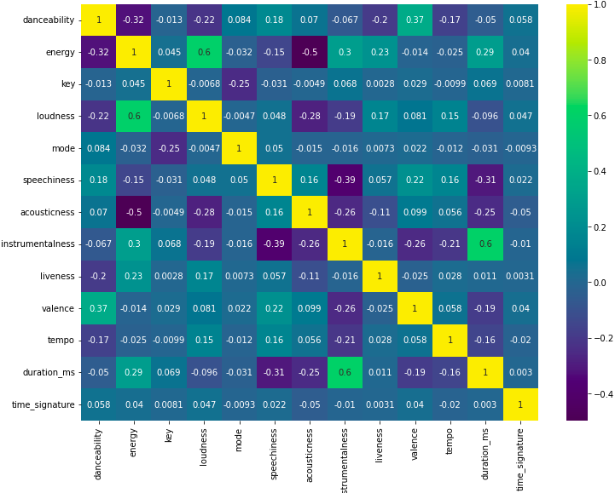
Correlated Columns HeatMap
No highly correlated columns
Moderate Correlation between -
1)Loudness and energy (Positive)
2)Instrumentalness and duration. (Positive )
3)Instrumentalness and speechiness. ( Negative )
4)Acoustic Ness and energy. ( Negative )

Slide 4
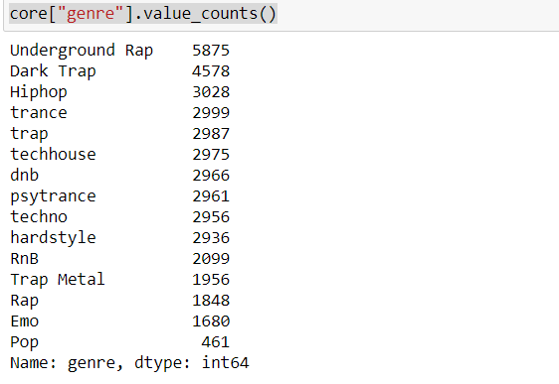
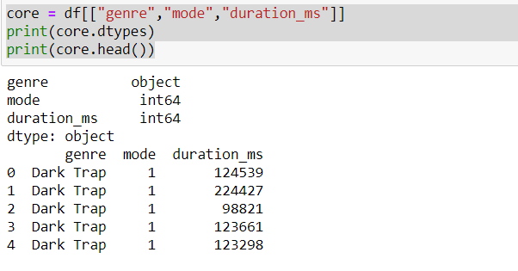
We replaced the NULL values in the song_name column.
We checked for the classification of genre’s

Slide 5
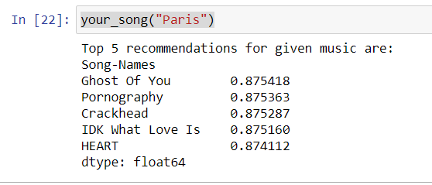
Artificial Intelligence Algorithm
In order to identify the low rank matrices, or approximations to the original input, we applied Non-negative matrix factorization. It obtains low rank representation of matrices with non-negative or positive elements. With the help of this, we were able to find the near approximations of the songs selected by the user.
Post applying NMF, we applied normalization, which arranges the data in a meaningful manner, reduces redundancy, and stores data in one place and removes duplicacy. After normalizing the data, we entered an input "Paris", which is a song name, and we got 5 recommendations that are closest to our input "Paris".

Slide 6
Next Steps
1)We will be optimizing our model by performing further detailed analysis on our attributes.
2)Formatting datasets and joining them with our current dataset so that we can have more rows.
3) Using are spotify API to finding missing song names using the song id column.

Slide 7
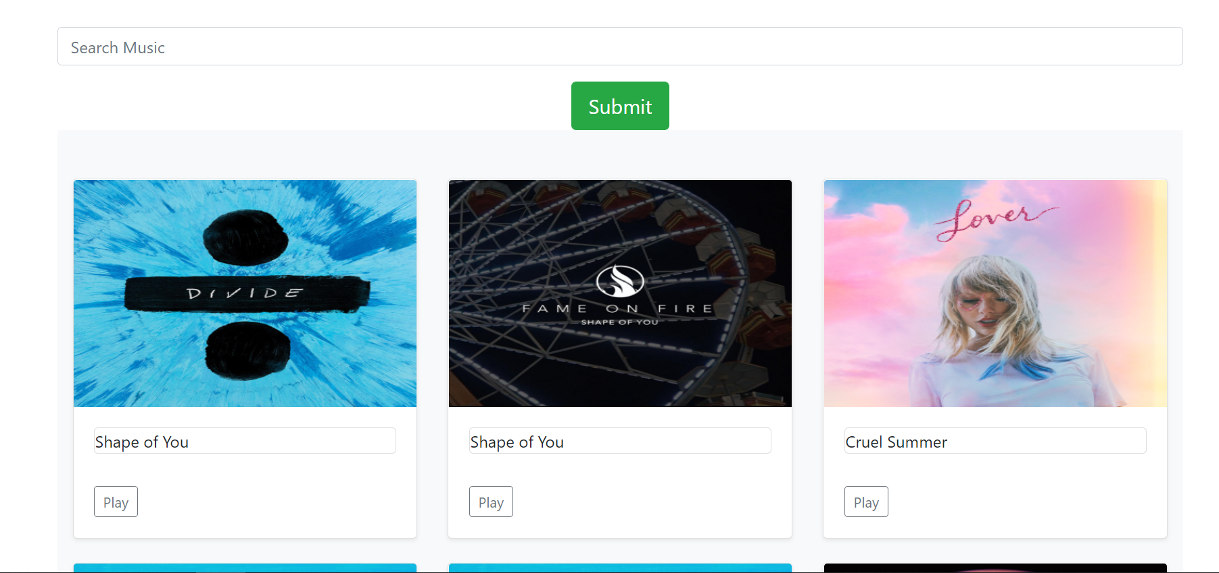
Project UI
Home screen to search the songs using Spotify API, it will suggest 9 songs based on song name entered by the user.

Slide 8

Once user clicks on a play button, other window will open to play the preview for clicked song.

Slide 9
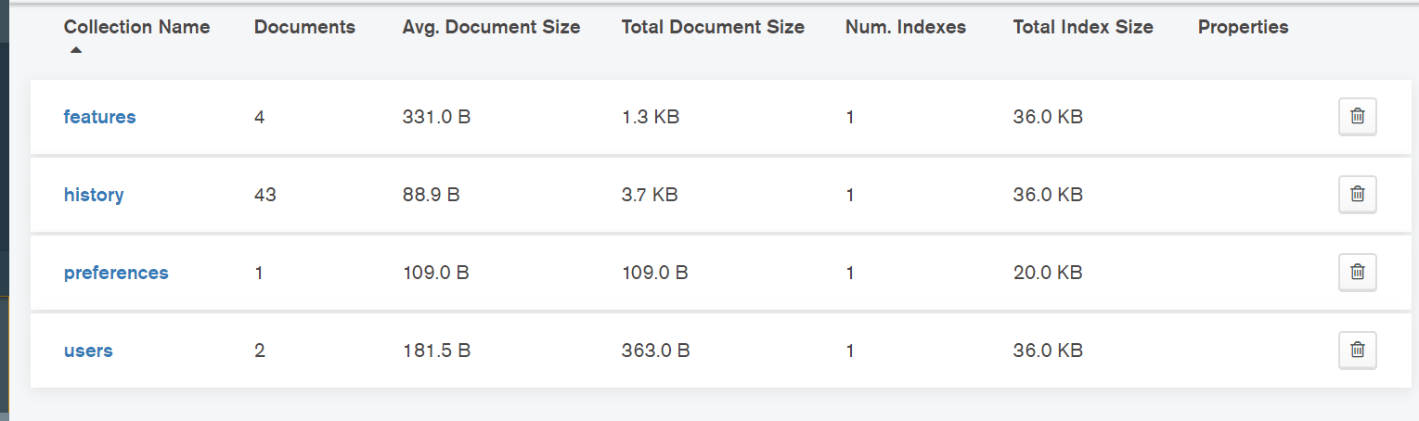
Once a song is played, based on the ID of the song the features are retrieved using Spotify API and stored into the Features table.

Slide 10
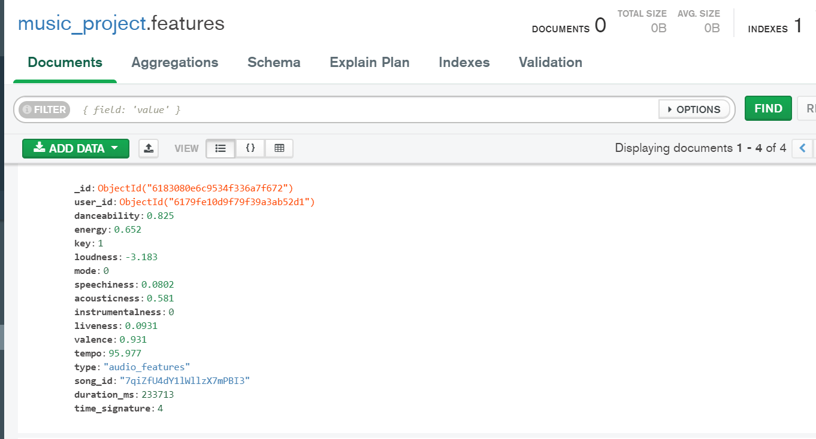
For each song played, individual entry is created in Feature table for user.
Based on these features, new songs will be suggested to the user using the algorithm.

Slide 11
GitHub Link : https://github.com/ronakumar97/music-recommendation-system

Slide 12
Thank You !

